Slide 1
PPG Meeting Presentation
New Addington Group Practices Parkway, Fieldway & Headley Drive
Wednesday 13th September 2023 18:00

Slide 2
Agenda
Purpose of a PPG meeting
Underserved community study – Judith
Staffing update
Community events
Practice updates - New triage system in place - New reminder process, improvement in DNA rates - Hypertension focus with the PCN - Performance packs, how we are driving - Flu season, current flu plans in place - PLT training afternoon - You said we did
Promoting for new PPG members

Slide 3
What is a PPG?
A Patient Participation Group (PPG) is a group of people who are patients within the practice who want to help improve the practice work well for all involved, including patients, doctors and staff.
PPG for Practice PPG for Patients
Develops a partnership/ relationship with patients
Supports health awareness and promoting patient education
Provides an opportunity to listen to patient feedback & suggestions.
Allows patients to be more involved & knowledgable of the care & services provided
Provides opportunity to make suggestions on how the healthcare they receive can improve
Chance to provide feedback to improve overall service
The PPG meeting is not a complaints forum, and this is not the correct setting to raise a complaint, this must be enacted in line with our complaints procedure.
These meetings should be positive, focusing on improving the practice and patient experience

Slide 4
Underserved Community Study
Please welcome Judith! ☺
Judith is here to present how to improve our efforts to deliver increased representation of underserved populations in clinical research studies delivered across our primary care networks.

Slide 5
Staffing Update - Clinical
Clinical Team | Job Role
Dr Ho-Man Kwong | Regional Medical Director
Dr Claire Norris | Regional Medical Director
Dr Abdul Badran | Clinical Lead
Dr Oludare Ogunyemi | Salaried GP
Dr Benjamin Worsfold | Salaried GP
Dr Faisal Patel | Salaried GP
Dr Philip NG | Salaried GP
Dr Midhat Syed | ST2
Dr Beth Selwyn | F2
Nursing/HCA | Job Role
Galina Twum Ayisi | Practice Nurse
Evelyn Pindura | Locum Nurse
Laura Fry | Healthcare Assistant
Diane Rose | Healthcare Assistant
Faith Beadon | Phlebotomist/Trainee HCA
AHP Team | Job Role
Onyekachi Chukwuocha | Pharmacist
Faustina Nyarko | Pharmacist
Mohammed Abdel-Aziz | Pharmacist offsite
Ibrahim Salih | Paramedic
Other Staff | Job Role
Farhad Ali | Social Prescriber
Mahima Verma | Physiotherapist

Slide 6
Staffing Update - Administrative
Management Team | Job Role
Kuljeet Sodhi | Regional Manager
Nicola Shergold | Practice Manager
Mohammed Ismail | Services Manager
Shelley Robinson | Assistant Manager
Reception Team | Job Role
Jayne Sands | Receptionist
Marie Barr | Receptionist
Rachel Hill | Receptionist
Tammy Townsend | Receptionist
Michael Downie | Receptionist
Nichola Sheehan | Receptionist
Tia Buckman | Receptionist
Kellie Arslan | Receptionist
Adebowale Adeogun | Receptionist
Charlotte Sheehan | Receptionist
Joseph Cahalane-Farr | Receptionist
Administration Team | Job Role
Faith Beadon | Senior Administrator
Lucy Benham | Senior Administrator
Paige Bennion | Senior Administrator
Emily Bigge (maternity) | Senior Administrator
Latoya Wright | Senior Administrator

Slide 7
Community Events
We have previously been involved with many events within the community however have not done any recently.
We would welcome some suggestions on any events you feel may benefit the practice.
Others which some of our other sites have done include…
Diabetic education event
Womens/mens health event
Mental health awareness
Community engagement

Slide 8
Practice Updates
New triage system in place
New reminder process, improvement in DNA rates
Hypertension focus with the PCN
Performance packs, how we are driving
Flu season, current flu plans in place
PLT training afternoon

Slide 9
Practice Updates
New triage system in place
Reminder process/DNA
Text reminders activated
Verbal reminder process
We have implemented the above in an attempt to improve DNA Rates within the practice.
May-July we had 910 appointments which were not attended across all sites.
From 01/01/2023 – 30/06/2023 we offered 6605 appointments, with 20% of these not attending.
We have implemented a new triaging system within the practice, managed by the clinical lead & senior admin team.
The system involves constant oversight of the list, with the most appropriate appointment being offered with the most suitable clinician.

Slide 10
Practice Updates
Hypertension Focus PCN
Performance Pack
We are currently working with our PCN pharmacy team on a project involving improving the quality of review and blood pressure targets for those with Hypertension.
Croydon's average performance for this in relation to QOF is a lot lower than other boroughs, so focus is on improving this for our patients.
Please see the attached performance pack which shows how we are currently driving in comparison to other sites within Operose.
These are our primary focuses and a lot of effort from both the admin and clinical team is being put into ensuring these patients are reviewed.

Slide 11
Practice Updates
Flu Season & plans
PLT Training afternoon
Flu season is here, and we are ready!!
We have ensured we have plenty of fully trained staff able to vaccinate across the three sites with a number of clinics available each day, including pre-bookable and walk in clinics both during the week and weekends.
Full list of clinics are being uploaded onto the Practice Website in the coming days.
On Wednesday 27th of September, our GP’s are attending training off site, covering Paediatrics.
The Practices will be closing from 12:30 on this day with out of hours cover being arranged.
There will be training for our administration staff, including care navigation & active signposting delivered by Croydon Training hub

Slide 12
You Said – We Did
Wanted easier access on the phones.
We have taken many efforts to reducing waiting times on phones, including ensuring we have more staff available at busier periods, such as a Monday morning.
We have also implemented the ‘call back’ feature – which activates when the call queue is longer than 5 people. Your place in the queue is safe & we will call you back without the need to wait! ☺
For a while now, we have had the DR IQ app which is open 5 days a week for medical enquiries, and 7 days a week for administrative queries. Our average response time is 70 minutes.
Easier access to healthcare professionals
Increase in face to face appointments
We have recruited several new clinicians, including GP’s, a new full time practice nurse and are in the process of training a new HCA. We also have increased availability for social prescribing, physiotherapist and pharmacist appointments.
We have increased the number of all clinicians across the sites. Including an increase in salaried GPs, meaning more continuity. We also now have 2 nurses at the practice, 2 HCA’s with another training. We also have a lot of other staff such as a physiotherapist and social prescriber
More staffing for continuity

Slide 13
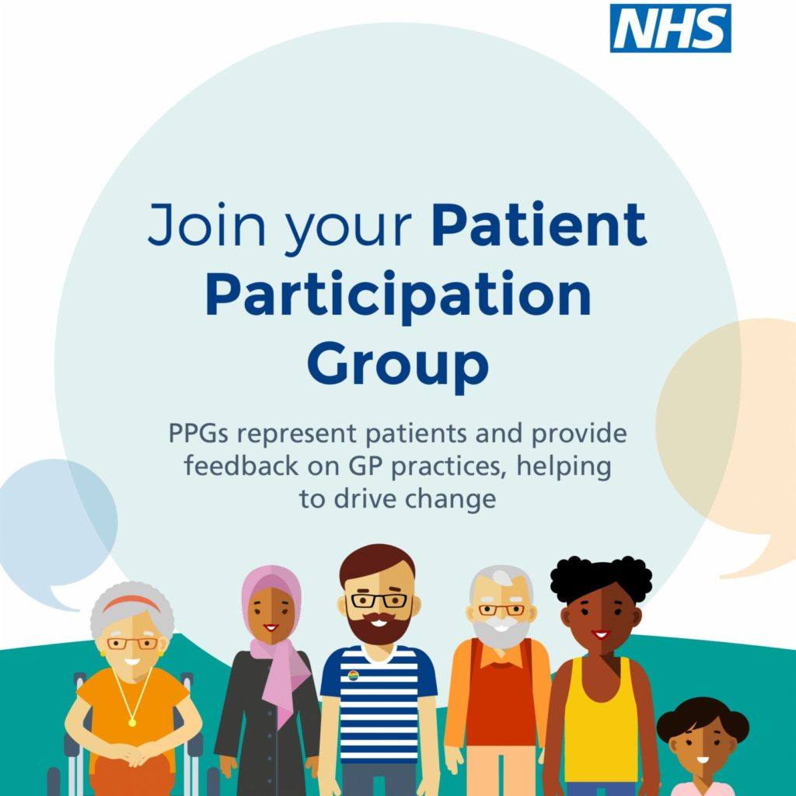
Promoting New PPG Members
How can we actively promote new PPG members to join the practice?
We have organised posters to be displayed within the practice.
We have contacted our comms team to put an emphasis of our need of new members on the website.
Community event? To help promote

Slide 14
PPG comments
Topics of discussion brought by the PPG listed below. Any other subjects raised within the meeting will be included within the minutes.
Concerns over call waiting times and queues
Concerns over appointment availability

Slide 15
Any Other Business

